Slide 1
Real-Time Sound Analysis / Synthesis
Michelle Qiu
Germain Martinez
Gerzain Mata

Slide 2
Overview
The user sings/ hums/ plays an instrument
A microphone picks up the sound
The sound is saved onto memory for later playback
Audio effects can be added to the sound samples
Two audio samples can be recorded

Slide 3
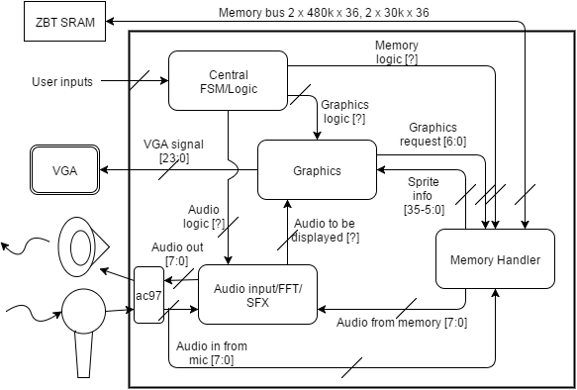
Block Diagram

Slide 4
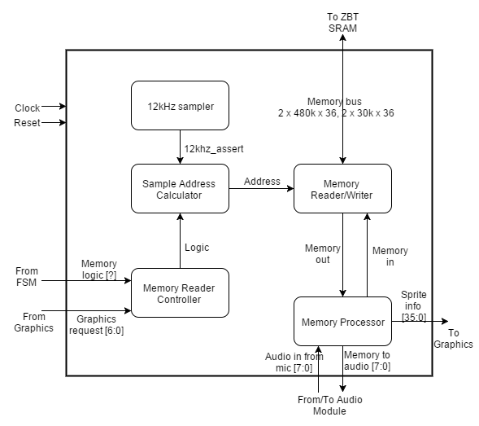
Memory Handler – Block Diagram

Slide 5
Memory Handler
Take in input from microphone
Write audio samples to memory
Retrieve sound samples from memory
Retrieve image data from memory for Graphics Module
Bus Sharing – Image and Audio share memory bus
Use ZBT Memory – two 512k x 36 bit memory bus

Slide 6
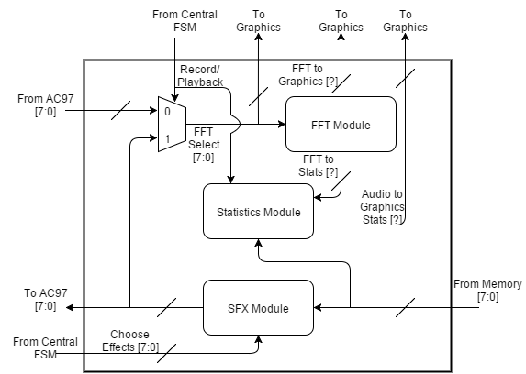
Audio Module - Block Diagram

Slide 7
Audio Module
Take input from MICROPHONE and write to memory
Take EFFECTS from FSM and apply them to recorded audio
Output FFT data to Graphics module
Output sound to SPEAKER
Most complex part of project

Slide 8
Proposed Effects
Compression & Limiting
Delay & Echo
Expansion & Noise Gate
Phasing
Chorus (if time allows)

Slide 9
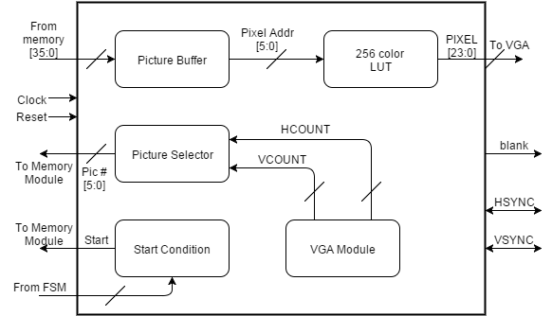
Graphics Module – Block Diagram

Slide 10
Graphics Module
Take in graphics from memory
Output FFT spectral data
Display running statistics (predominant frequency, amplitude, sample characteristics)
Take in data from ZBT memory
36 bit bus → 6 bit pixel encoding = 6 pixels per memory read
6 bit pixel encoding -> 24 bit color to VGA -> LUT
30+ different images for text/numbers/etc.

Slide 11
Central FSM
Coordinates the modules
Each team member implements part of the FSM most pertinent to their individual module
Choose which bank to record to and what effects to apply

Slide 12
Specific Number Figures
24 kHz sampling rate and 12 bit encoding scheme
288 kilobits per second data rate
~80 kSlots of ZBT memory required for 10-second recording
Use one bank of memory for each sound recording
Necessary to leave space for image data

Slide 13
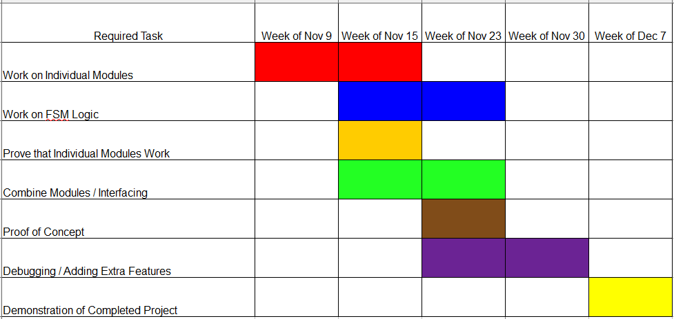
Task Timeline

Slide 14
Forseeable Challenges
Sharing memory between audio and graphics
Getting FFT statistics in real-time
Simultaneous and offset playback of different recordings

